Slide 1
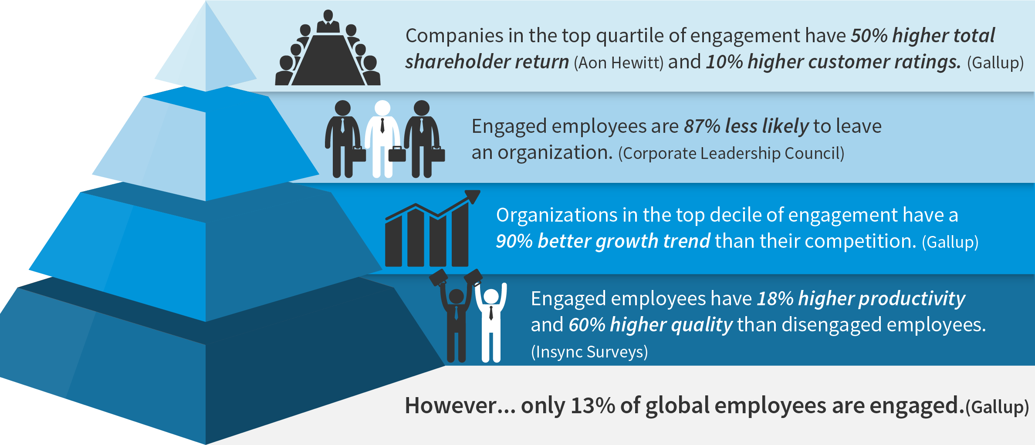
How to engage senior leaders in culture change

